Slide 1
Easy Questions First? A Case Study on urriculum Learning for Question Answering
Mrinmaya Sachan Eric P.Xing

Slide 2
MOTIVATION
Ordering a complex task into a sequence of easy to hard problems can imporve the model learning.

Slide 3
RELATED WORK
Curriculum learning(CL)(Bengio et al., 2009) and self-spaced learning(SPL)(Kumar et al., 2010) have been recently introduced in machine learning literature.
CL:The examples are not randomly presented to learn but organized in
a meaningful ordel.
SPL:Combine the selection of the curriculum and the learning task in a single objective.

Slide 4
TARGET
Learning a curriculum in the context of non-convex models for question answering from easy to difficult, and consdering the diversity of samples.

Slide 5
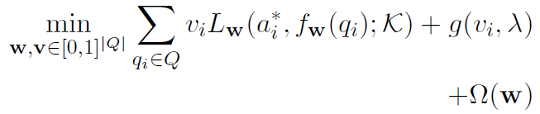
Curriculum Learning
ERM framework is rewritten by SPL as:
Here, is the weight vector of samples. is an additional self-paced regularizer. is called “age” or “space”.
The problem usually has closed-form solution

Slide 6
Curriculum Learning
is monotonically decreasing with respect to L.
is monotonically increasing with respect to

Slide 7
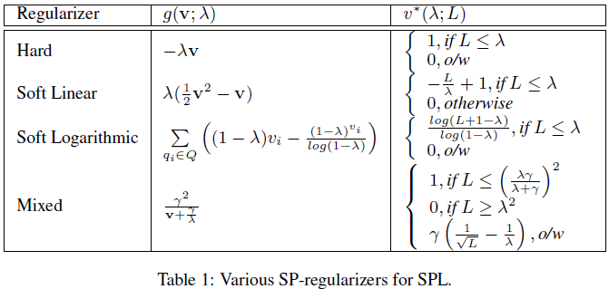
Self-paced Regularizers

Slide 8
Curriculum Learning
The whole process:Updating v and w iteratively, and gradually increasing the to let harder problems in.
We can think of CL as a strategy for achieving a better local-optimum in non-convex problem.

Slide 9

Improved Curriculum Leanning Heuristics
Greedy Optmal(GO) | training with and , and pick the with the minimum loss.
Change in Objective(CiO) | training with and , and pick the that causes the smallest increase in objective.
Mini-max (M2 )
Expected Change in Objective (ECiO) | training with the new question, and pick the that causes the smallest increase in objective.

Slide 10
Improved Curriculum Leanning Heuristics
Change in Objective-Expected Change in Objective (CiO - ECiO) | pick the question with the minimum difference between Cio and ECiO.
Correctly Answered (CA) | pick the question tesed in the model with the minimum loss.
Farthest from Decision Boundary (FfDB) | pick the question whose predicted answer is farest from the decision boundary.

Slide 11
Smarter Selection Strategies
1)Ensemble Strategy: vote strategy
2)Importance-Weighting(IW): build the biased sample distribution,
and re-sample.

Slide 12
Explore and Exploit(E&E)
Define a measure for diversity:
The E&E solution picks the question (CL objective + sample diversity)

Slide 13
SETTING FOR QA
each question:
candidate answers:
correct answer:
score function: model parameters w;background K
prediction rule :
object:

Slide 14
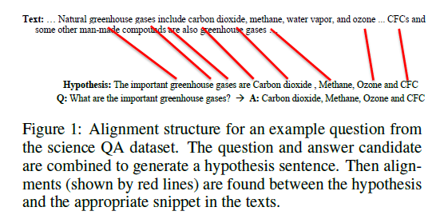
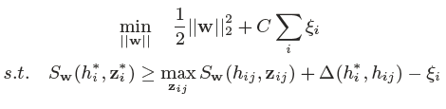
QA Models
1.Alignment Based Models
Optimization object:

Slide 15
QA Models
2.Deep learning models
QANTA: QANTA answers quiz bowl questions using a dependency tree structured recursive neural network.
Memory Network: recurrent neural network with a long-term memory component.

Slide 16
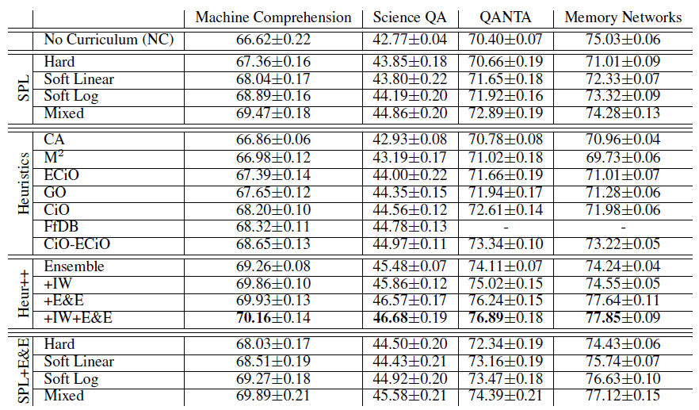
Experiments

Slide 17
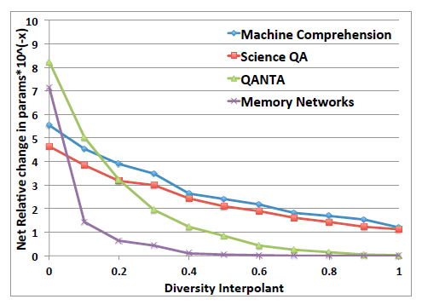
Experiments

Slide 18
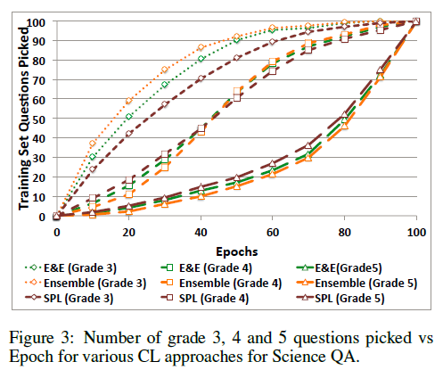
Experiments

Slide 19
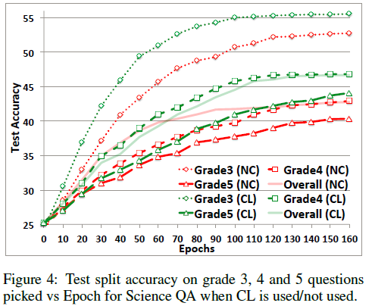
Experiments

Slide 20
References
[Bengio et al.2009] Yoshua Bengio, J´erˆome Louradour,Ronan Collobert, and JasonWeston. 2009. Curriculum learning. In Proceedings of the 26th annual international conference on machine learning, pages 41–48. ACM.
[Kumar et al.2010] M Pawan Kumar, Benjamin Packer, and Daphne Koller. 2010. Self-paced learning for latent variable models. In Advances in Neural Information Processing Systems, pages 1189–1197.

